Slide 1
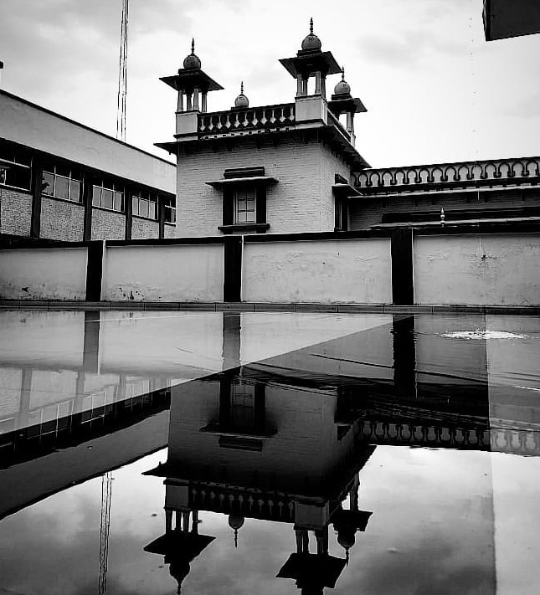
Digitalization of
Recovery Certificate
July 8, 2019

Slide 2


Board Of Revenue,
Govt. of Uttar Pradesh
Birla Institute of Technology and Science, Pilani

Slide 3
Group Members:
Shardul Tamane 2017ABPS1332H Manufacturing
Harsh Nagpal 2017AAPS1734H Electronics & Com.
Vibhor Jain 2017B3A10654P Economics and Chemical
Roshan R Nair 2017B3A31005G Economics and Electrical
Arpit Shukla 2017B3A31009G Economics and Electrical
Jai Arora 2017B1A30876H Biological Science and Electrical
Kirti Vatsal Mishra 2017B4AA0995H Mathematics and Electronics.
Sarthak Chowdhury 2017B5AA0909H Physics and Electronics.

Slide 4
Introduction
About Recovery Certificate
It is a certificate issued by the Organisation for dealing with defaulters.The main spectra of the RC currently lies with the electricity companies.
Certificate is circulated between multiple departments , finally reaching the chairman who has the authority to decide what to do with the defaulter.
Hierarchy in UP
There exists an elaborate hierarchical structure in the process of recovery when there is a default in payment.
Our team was tasked with creating webforms which will make the process of issuing a recovery certificate more fast,efficient and hassle-free.

Slide 5
Hierarchy in UP
Collector/Deputy Commissioner.
Tahsildar
Tahsildar
Deputy Tahsildar
Deputy Tahsildar
Deputy Tahsildar
Deputy Tahsildar
Revenue Inspector
Revenue Inspector
Revenue Inspector
Revenue Inspector
Revenue Inspector
Village Admin. Officer
Village Admin. Officer
Village Admin. Officer
Village Admin. Officer
Village Admin. Officer
Village Admin. Officer

Slide 6
First Draft:
The first draft for the webform contains all the required fields necessary for generating a recovery certificate.
The form was created using <form> tag which and all the input fields were inside it.
Styling was done using CSS and colours were added so that the webpage looks compatible with the site.
The required fields are determined on the basis of a choice given to the user.

Slide 7
How the First Draft Works
The user is asked whether the issuer is a person or institute
A drop down menu is provided for some input fields so that the user can choose from a set of choices.
The user proceeds to submit the details and the information is stored in a database.
Step 1
Step 3
Step 5
Step 2
Step 4
Fields are generated on the basis of the choice entered.
The user is asked to fill in important details like Vibhag ka Vivaran

Slide 8
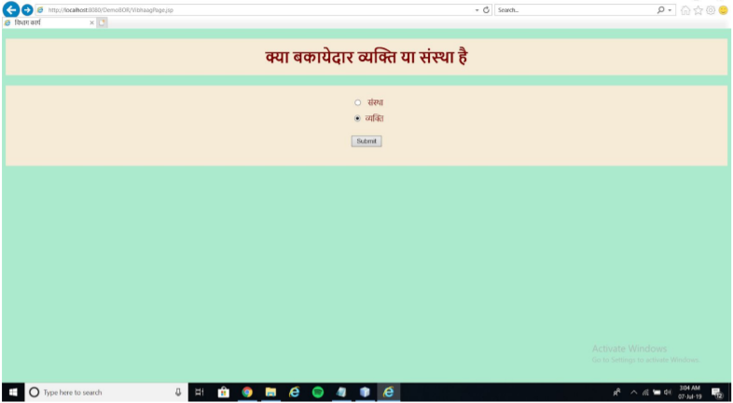
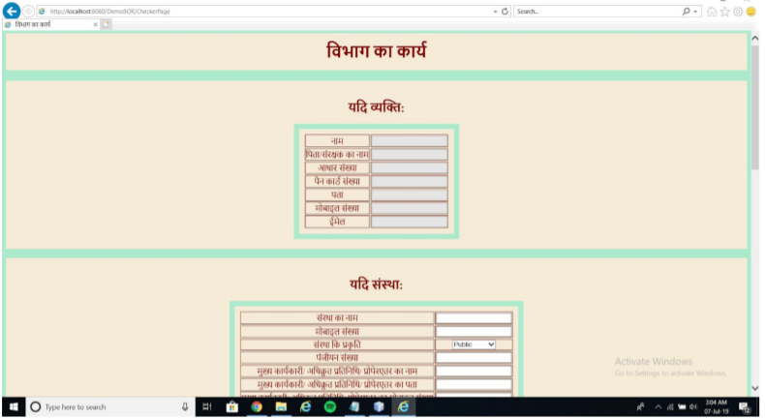
First Draft(Screenshots):

Slide 9
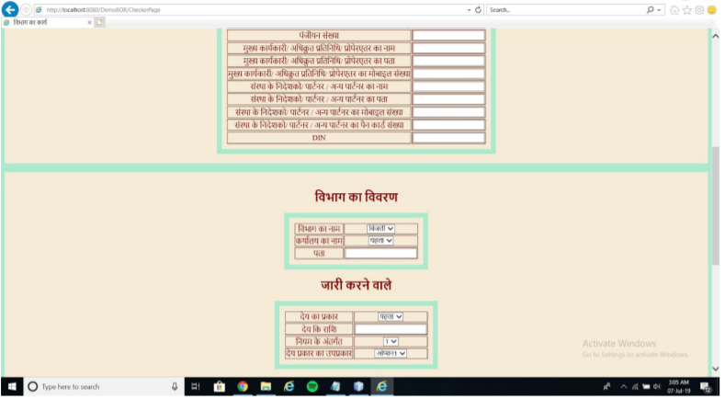
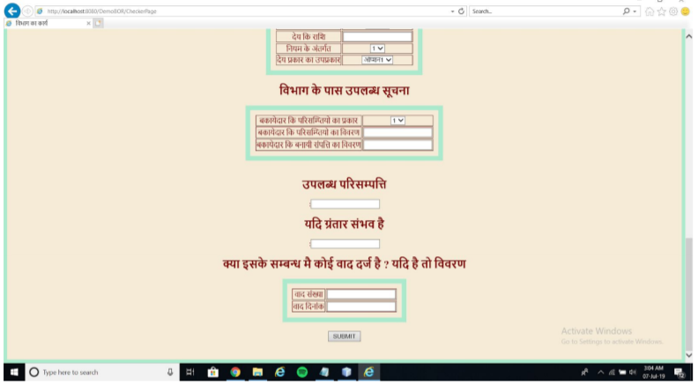

Slide 10
Second Draft:
Using Bootstrap
Addition of a Navbar
Changes to Code
To make the website attractive,bootstrap instead of CSS was used.
A code links the jsp file to the bootstrap and any device connected to the internet will run the bootstrap and display the page with the style .
A navigation bar was also added which improves the look of the form.
Buttons were added using bootstrap instead of the radio buttons used earlier.
The “card” class was used for better design providing some pre-styled properties.
Placeholders were used to make the form user friendly.
The section tag was used which helps in formatting and design.

Slide 11
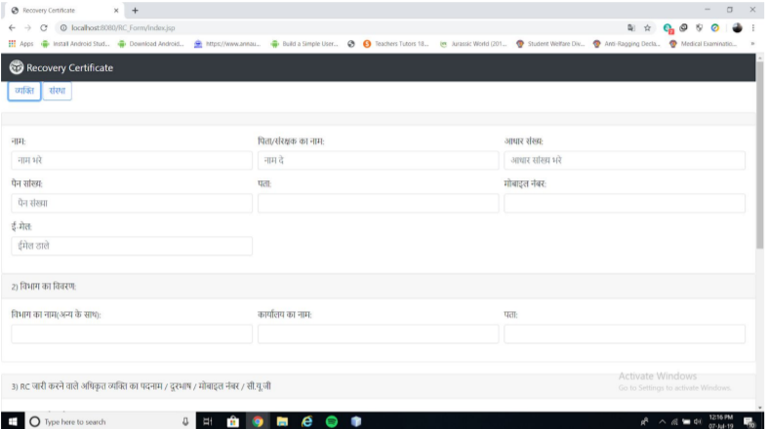
Second Draft:

Slide 12
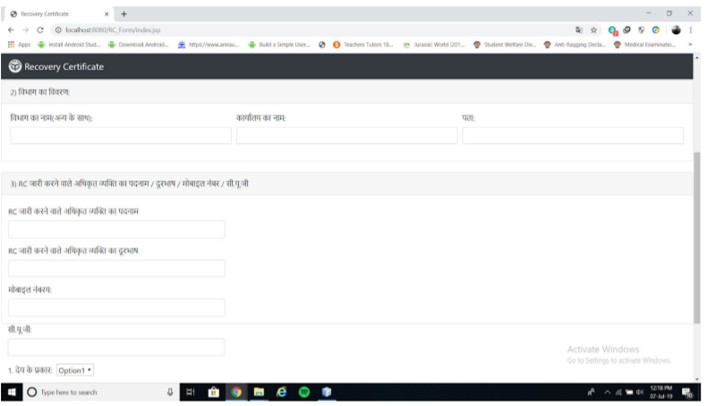
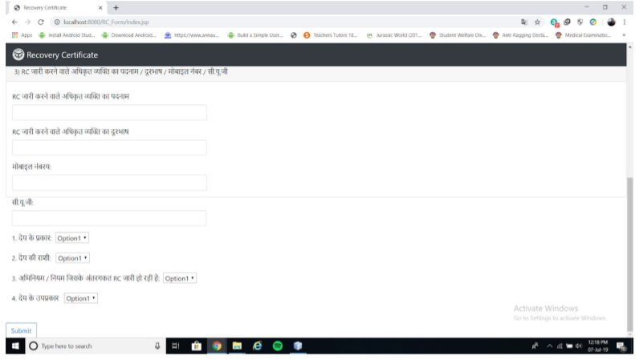

Slide 13

Database Management
The queries used for creating a database and a table are:
CREATE DATABASE testdb;
CREATE TABLE COMPANY
ID INT PRIMARY KEY NOT NULL,
NAME TEXT NOT NULL, AGE INT NOT NULL, ADDRESS CHAR(50), SALARY REAL );
The database used is called RCDatabase
PostgreSQL is used as the IDE

Slide 14
Working of the Database:
Apache Tomcat
All the data in the database was linked to the Apache Tomcat server.Tomcat provides an environment in which the JSP and Java Servlet files can run.
Connection Object
The Connection object is used to establish connection to the Database via the JDBC driver
Prepare Statement
The PrepareStatement Object is used to execute the SQL query statements from our JSP files
Web.Xml
The Web.xml or the Dployment Descriptor file was used for connecting the JSP files and mapping them together.

Slide 15
CHALLENGES AND PROBLEMS FACED:
Learning Java web apps using JDBC
Java had to be learnt in order to make the websites as per the architecture of the institution.
1
Generation of RC number in the limited timeframe
Generation of the RC number proved to be a very difficult task and could not be completed in the limited time frame due to lack of knowledge and experience..
2
Non CS background of the team
The Team consisted of 8 people, of which none had CS as their major degree, so the concept of DBMS and building of web applications was quite new to us.
3

Slide 16
Conclusion:
The main problem was the complexity of the process of issuing an RC.
The webform needs to be user friendly to ensure a hassle free experience.
The team worked together to make the final webform, keeping all the aforementioned prerequisites in mind.The styling was done using CSS and Bootstrap, making the webform more attractive.
The local population is comfortable with Hindi.
Different fields for both institutions and individuals are to be created

Slide 17
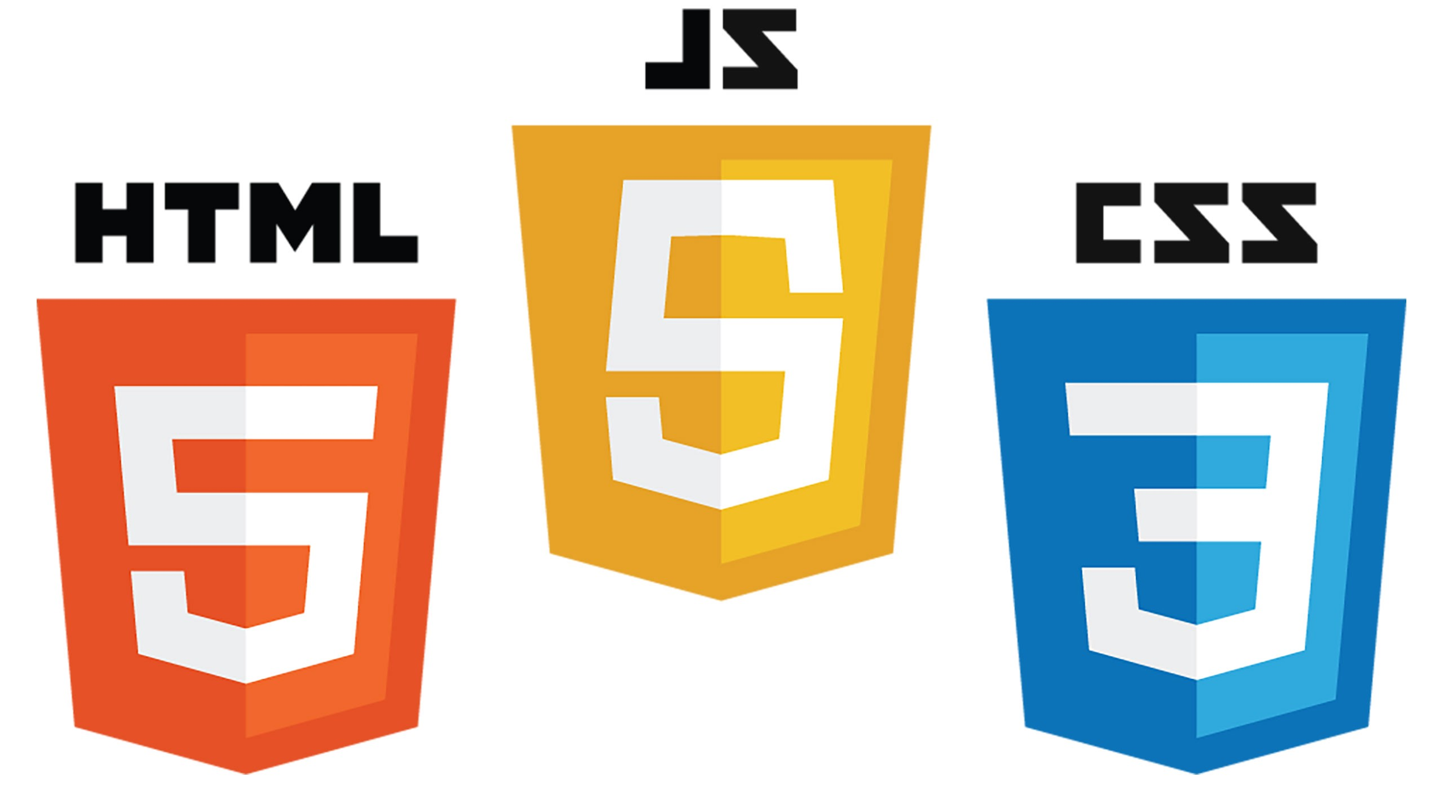
Conclusion:
The whole journey so far at BOARD OF REVENUE is nothing short of fascinating.
We were able learn multiple software including JSP, SQL and HTML/CSS.
We all experienced working in a professional environment and understood the scale at which the organisation operates.
We hope that the organisation deploys our RC form in the RC department successfully.

Slide 18
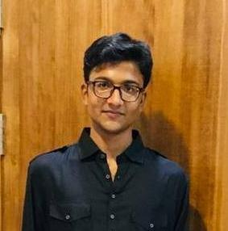
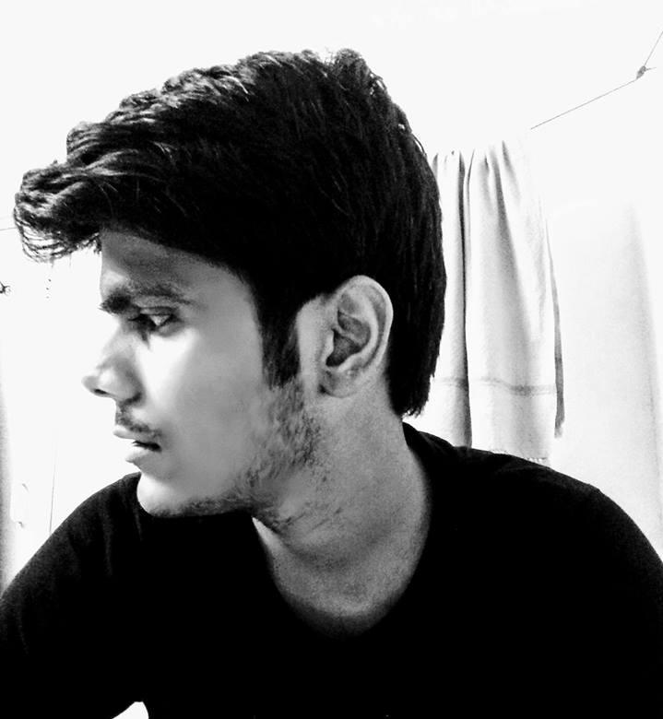
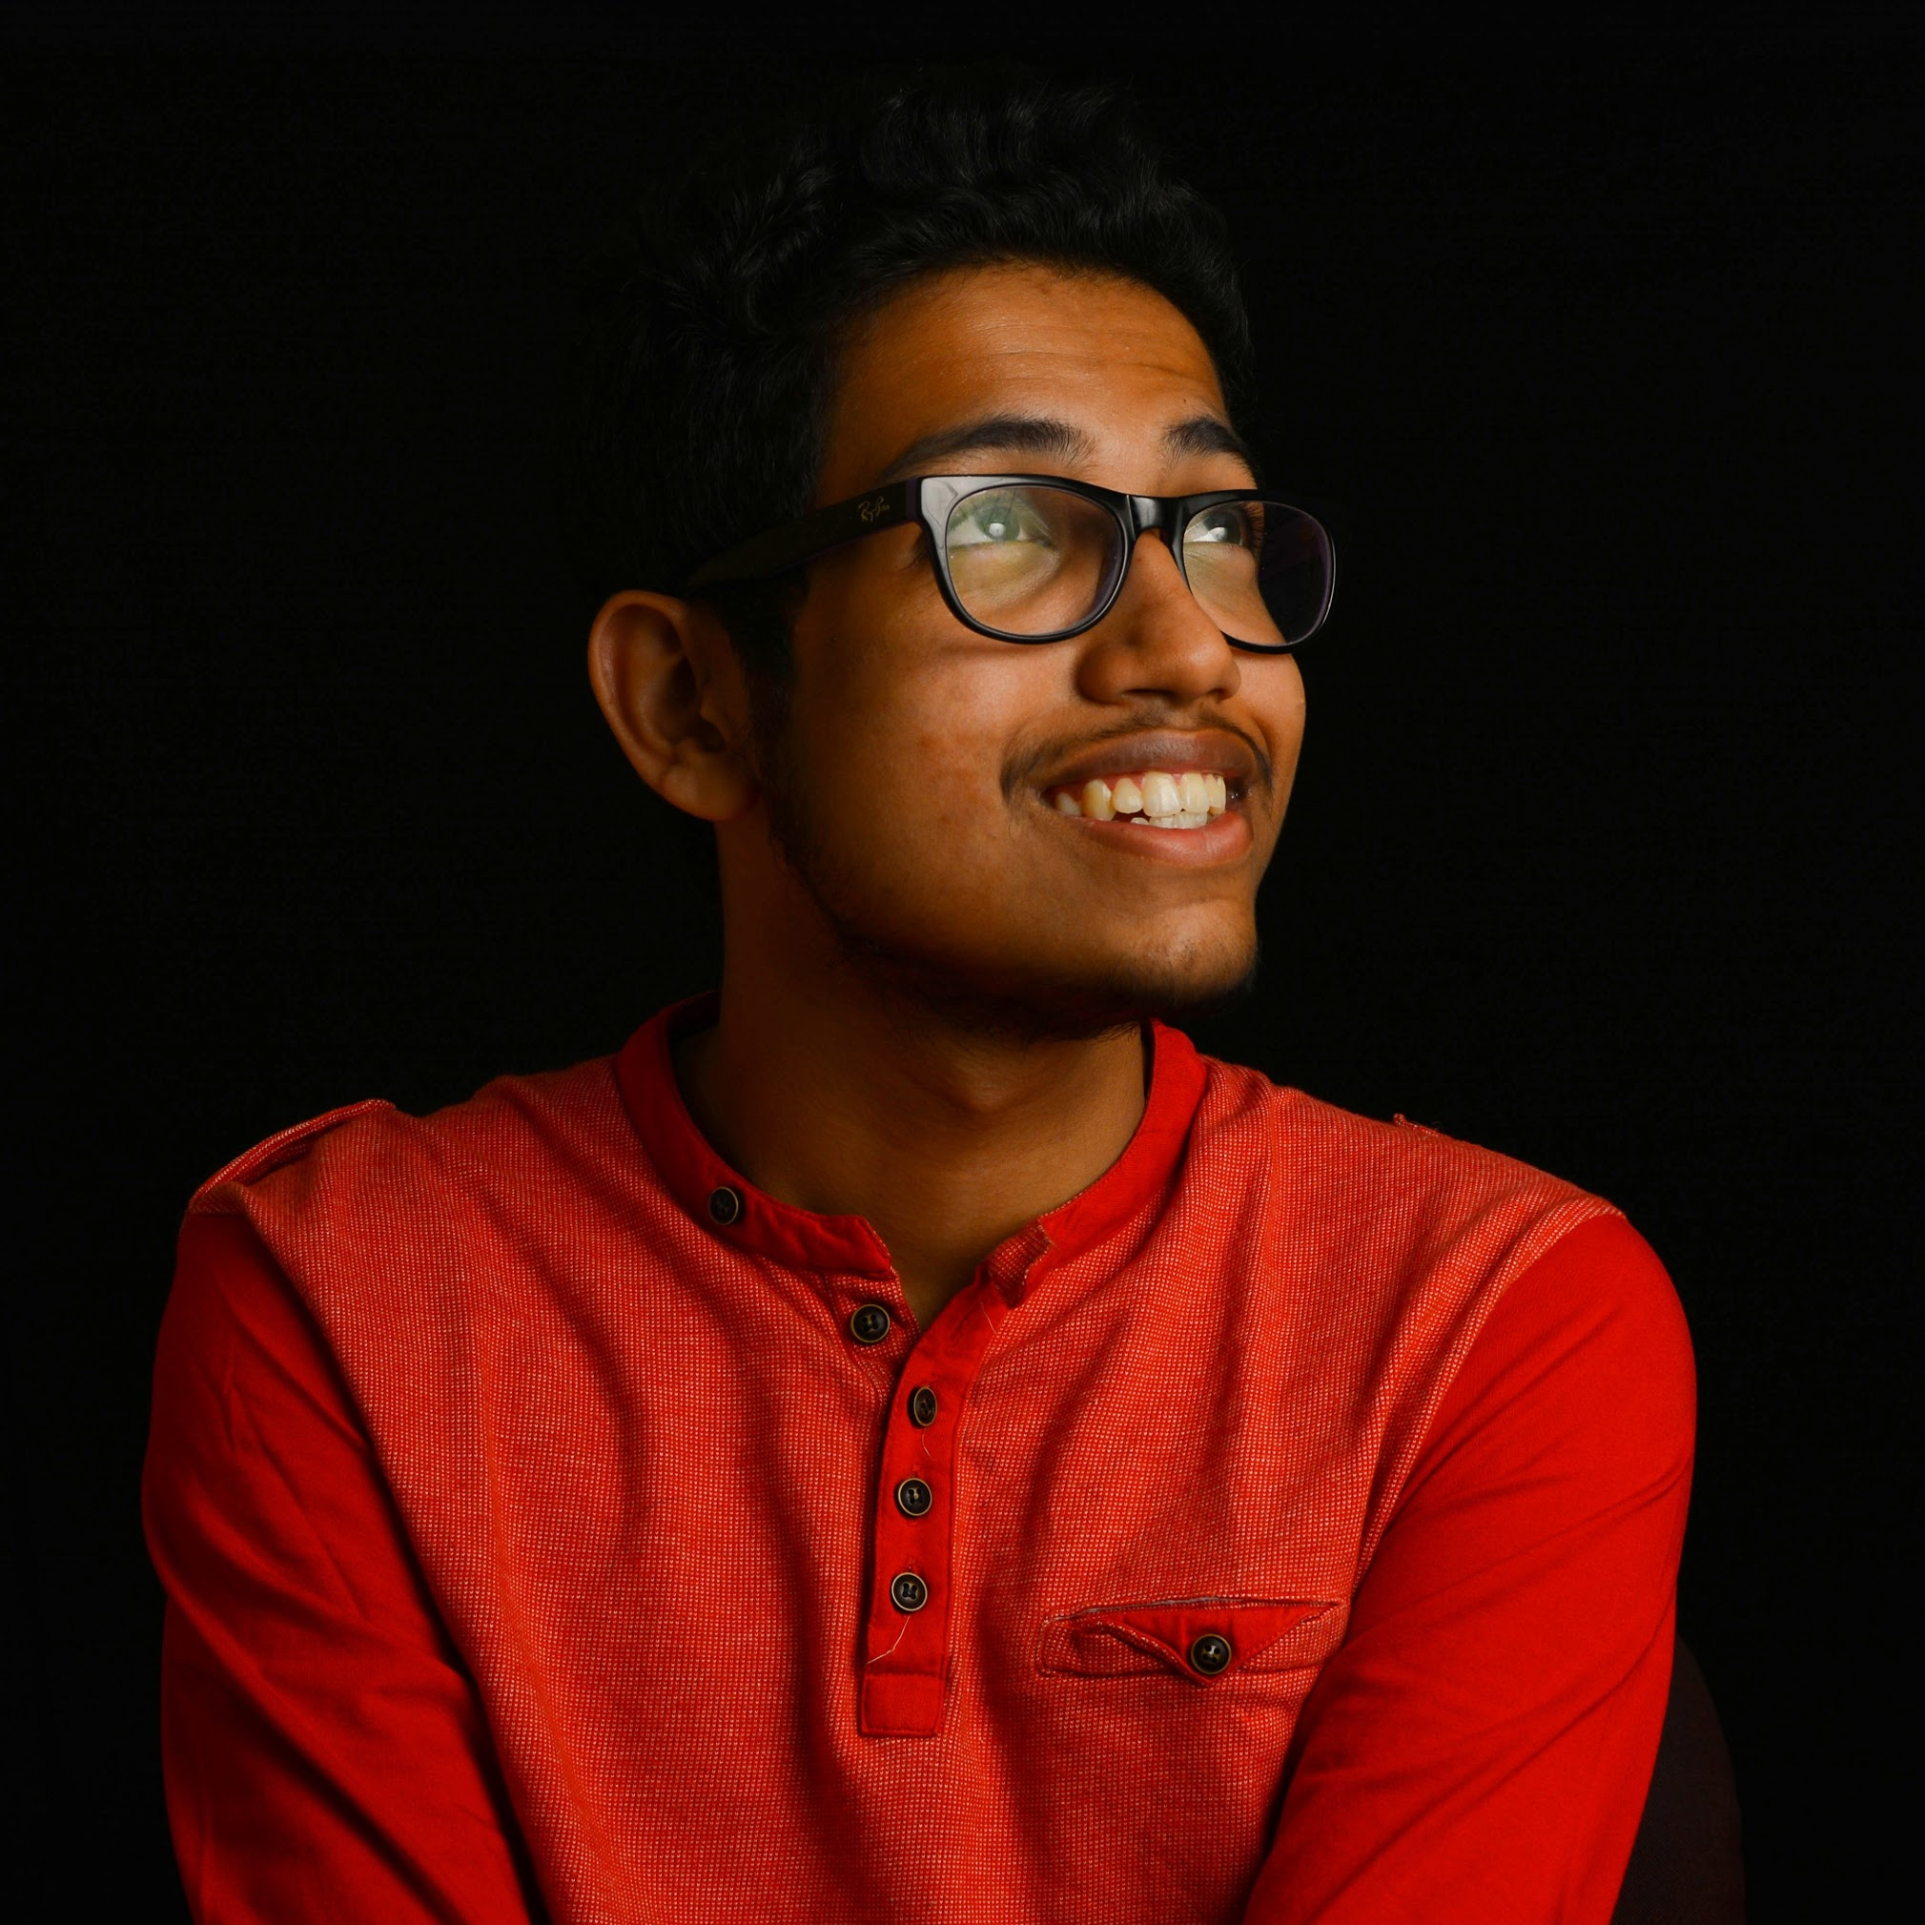
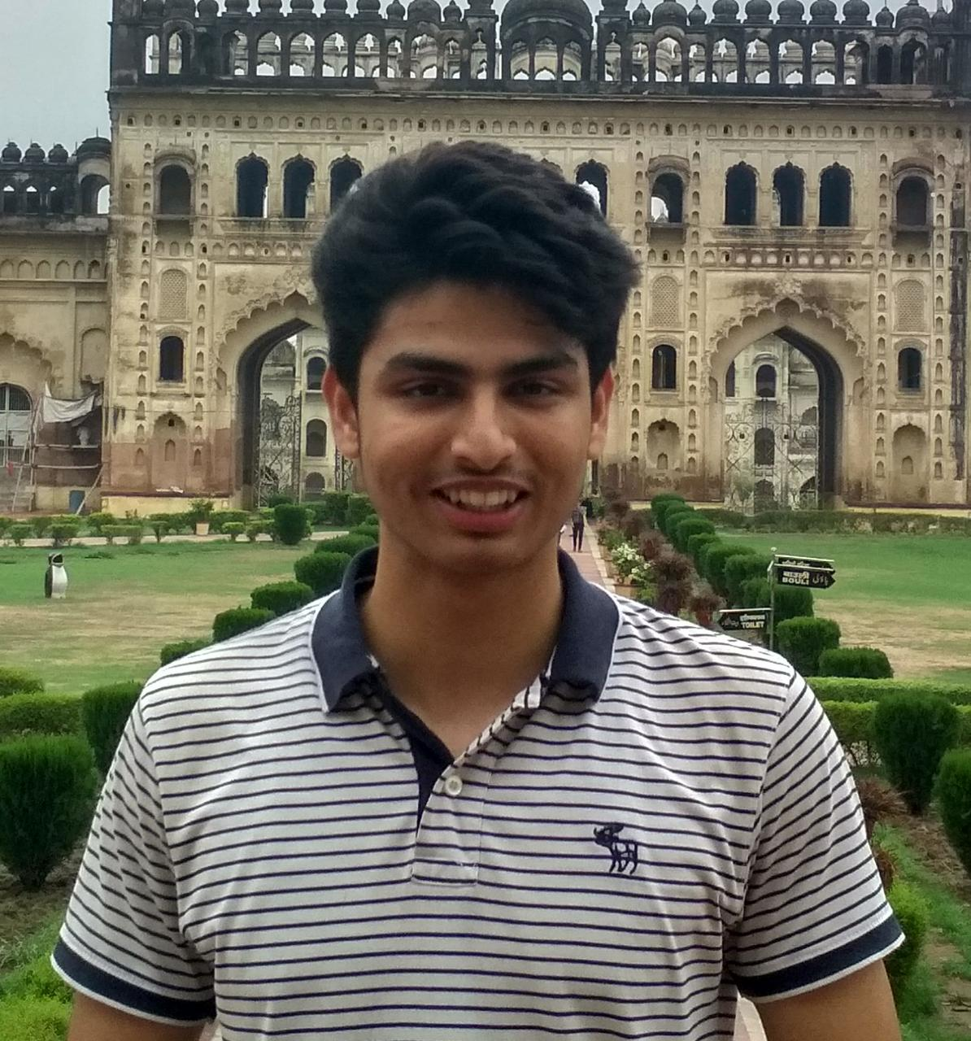
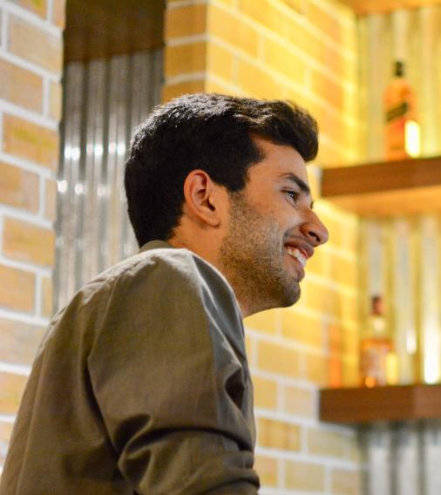
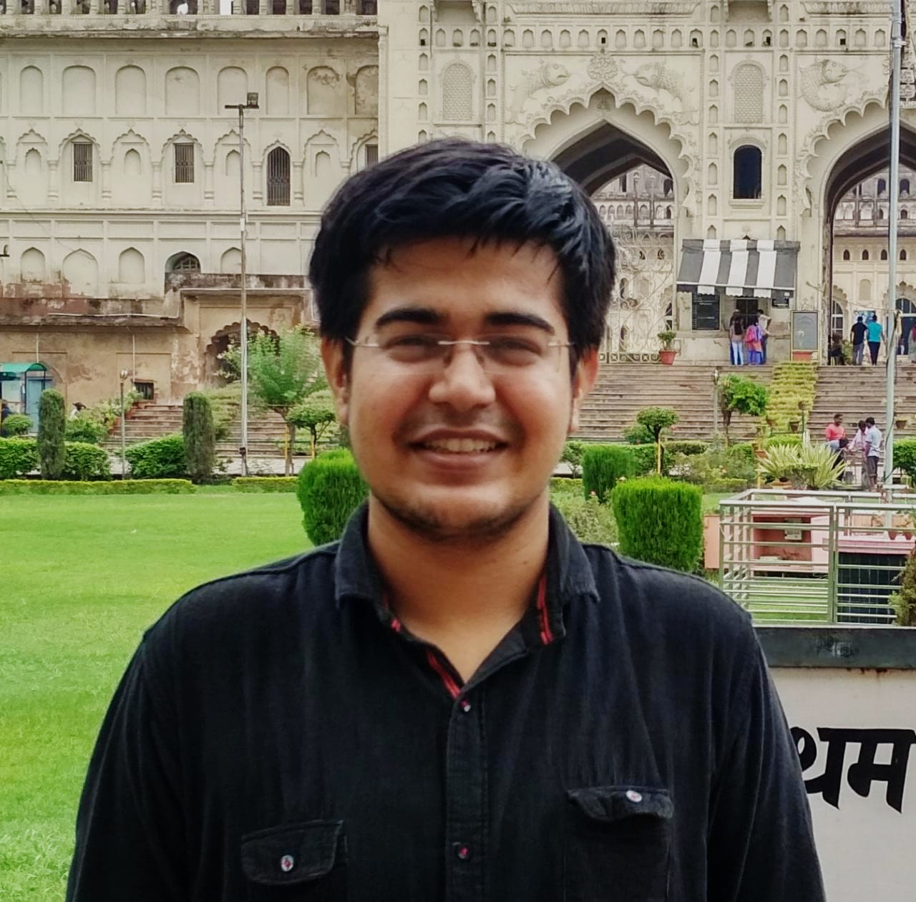
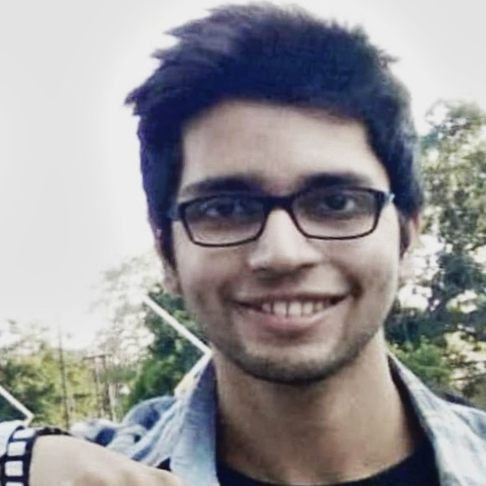
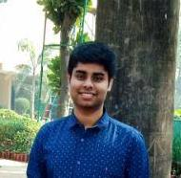
The Team
Shardul Tamane
Vatsal Mishra
Sarthak Chowdhury
Vibhor Jain
Jai Arora
Harsh Nagpal
Roshan Nair
Arpit Shukla

Slide 19
Thank You

